Slide 1
ITMD 536 Software Testing & Maintenance
Chapter 1 and 2 Maintenance Is Everybody’s Primary Business &
Software Maintenance Overview

Slide 2
Objectives
What is Software Maintenance?
Who does software maintenance?
How can you transition from development to maintenance mode?
What is required to do emergency fixes?
How do you structure effective regression testing?

Slide 3
Software Maintenance
Maintenance Process: The set of processes used to maintain and sustain software after it has been delivered. These processes involve more than just development. For example, they may address distribution control and adaptation to make the software work at different sites.

Slide 4
Software Maintenance
Maintenance Plan: Refers to a document that sets out the activities', schedules, practices and resources to be used to maintain a software product and generate a software release.

Slide 5
1.1 Software Maintenance
US has 32% of software developers are in different industries.
Remaining percentage are involved in software maintenance tasks.
There are large number of computer programmers are self employed.
Lower prevailing wages and higher educated workers are in India. Over 6 to 7 billion software projects are offshored

Slide 6
1.2 Goals and Scope
Refers to the process of keeping a product current after delivery. This involves updating the product to address new functionality and repairs and sustaining the facilities and infrastructure required to accomplish this tasks.

Slide 7
1.3 Maintenance Viewpoints
What work is involved?
While changes and fixes are performed, at least half the work involves other activities like sustaining engineering and field, user and product support.
What does the work?
Teams with the lease half the workforce being senior and experienced

Slide 8
1.3 Maintenance Viewpoints
3. What is the work done?
During both the development (for increments) and post -delivery
4. Where is the work performed?
At a maintenance facility that provides more capability than the development site (real equipment, users in the loop, etc.); patches are made at the operational site

Slide 9
1.3 Maintenance Viewpoints
5. What activities are typically performed during maintenance?
As much as 60 percent of the work involves testing; requirements analysis, reengineering, and other tasks consume the remainder
6. What are the primary drivers?
Backlog of new requirements and bug fixes

Slide 10
1.3 Maintenance Viewpoints
7. What are the primary risks?
Unrealistic expectations for efforts done on level-of effort (LOE) basis, inadequate budgets, facility shortfalls, and no visibility into progress
8. How do you measure success?
Deliver a release or version that performs at least as well as that which it replaces after modifications have been made to it

Slide 11
1.3.1 Product-user needs Requirements
Enhancements (new features and functionality) and repairs (bug fixes)
Good architecture is emphasized
Over 60 to 70 % of maintenance work revolves around software testing
Regression testing is used to for maintenance to follow the local/national rules, regulations and laws

Slide 12
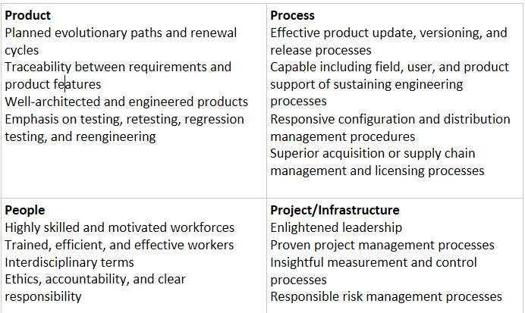
Four views of Software Maintenance

Slide 13
1.3.2 Process-Evolution and Change Management
Software life cycle starts with conceptual of a product and ends with its retirement. The product is developed based on requirements and is architected and designed with change in mind.
Documentation is required for change management.

Slide 14
1.3.2 Process-Evolution and Change Management
Capability Maturity Model Integration (CMMI) provide adequate structure for implementing a responsive process framework and improvement program.

Slide 15
1.3.3 People – Workforce Needs
Most experienced person should be assigned for the maintenance tasks.
Formulating requirements
Development work is more challenging than maintenance
Pay, prestige and rewards
Easy to recruit and retain developers than maintainers

Slide 16
1.3.4 Project deadlines & Management
Primary purpose – User req - defects
Basis – Tech req – Software Change req
Schedule – satisfy req – SCR batched
Effort – satisfy req – level of effort (LOE)
Primary activities – 40/30/30% – 25/20/55%
Work tasks – doc, CM, QM, PM –PM&UAT
Product – ISS documentation – schedule
Management techniques – WBS – Metrics

Slide 17
Software Maintenance
Make sure that testability is designed into products during development because of its impact during software maintenance.
Ensure that your process infrastructure is expanded to include unique maintenance practices.

Slide 18
Software Maintenance
Software maintenance is labor intensive, with the majority of costs arising form programmers’ salaries.
Software under maintenance production system failures occur randomly, and user requests come in on an irregular basis. Without agreed-upon and mature queue-management mechanisms supported by detailed service-level agreement. (SLAs).

Slide 19
Software Maintenance Issues
There are three different maintenance problems:
1. Problems of alignment with the organization’s objectives,
2. Process problems, and
3. Technical problems.

Slide 20
Software Maintenance Issues
Other maintenance problems are:
Poor traceability to the processes and products that created the software
Changes rarely documented
Difficulty of change management and monitoring
Ripple effects of software changes

Slide 21
Software Maintenance Issues
Technical Maintenance problems:
Inadequate testing techniques
Little methodology, few standards, procedures and tools specific to maintenance
Source code in existing software complex and unstructured

Slide 22
Software Maintenance Issues
4. Integration, overlap and incompatibility of existing system
5. Maintenance software runs on obsolete systems and technologies
6. There is a lack of automated testing and diagnostic tools for successful change implementation.

Slide 23
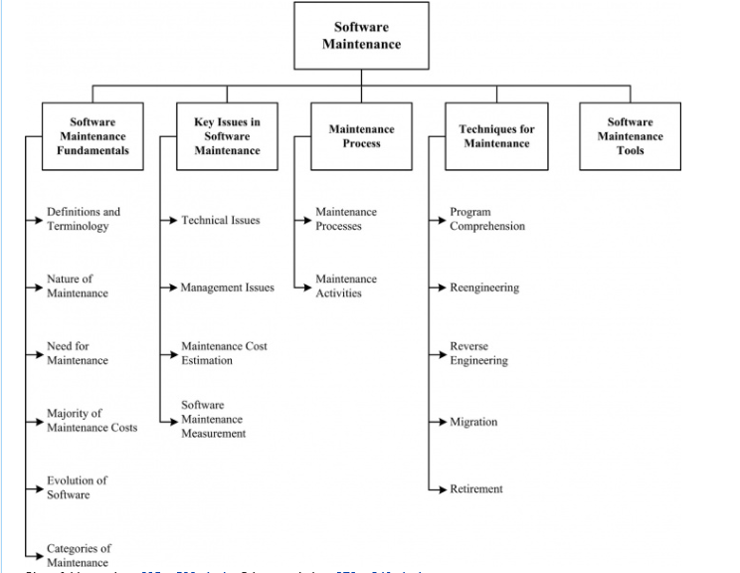

Slide 24
Fundamentals | Key Issues | Maintenance Process | Techniques | Tools
Definitions & Terminology | Technical Issues | Maintenance Processes | Program Comprehension
Nature of Maintenance | Management Issues | Maintenance Activities | Re-engineering
Need for Maintenance | Maintenance Cost Estimation |  | Reverse Engineering
Majority of Maintenance Costs | Software Maintenance Measurement
Evolution of Software
Categories of Maintenance

Slide 25
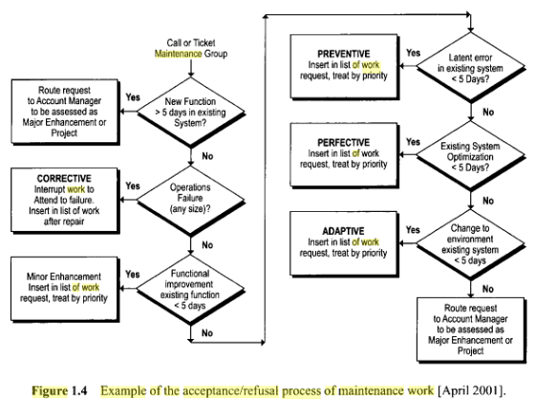

Slide 26
Software Maintenance Standards
ISO 12207 software maintenance process includes following six sub processes
Process implementation
Problem & modification analysis
Modification implementation
Maintenance review/acceptance
Migration
Software retirement

Slide 27
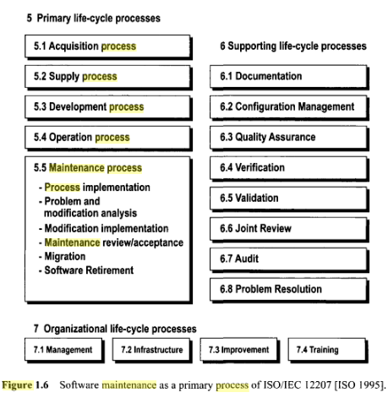

Slide 28
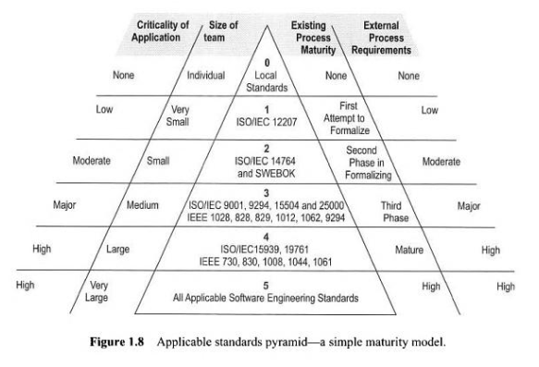

Slide 29
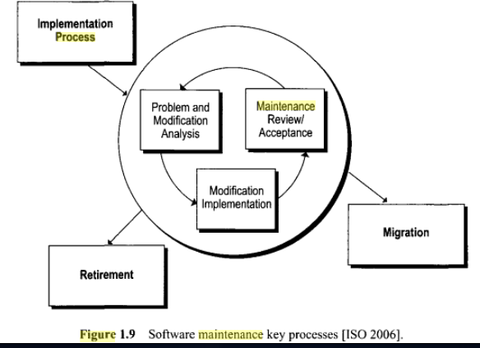

Slide 30
Software Maintenance Process
Application (Before)
Functional size
Lines of code
Environment characteristics
Maintenance Request
Number
Category

Slide 31
Software Maintenance Process
Effort
Person-days
Planned
Other Inputs
Tools
Administrative Services

Slide 32
Software Maintenance Process
Application(After)
Functional Size
Lines of code
Environment characteristics
Completed Requests
Number, Category
Functional size, Lines of code
Person-days

Slide 33
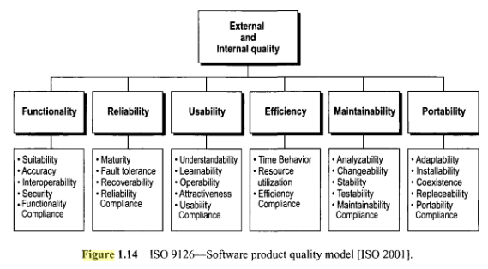

Slide 34
Service Measurements
There are three service level agreements in software maintenance:
Internal service-level agreement (SLA)
Maintenance service contract
Outsourcing contract

Slide 35
Internal Service-Level Agreement
Responsibilities of the maintenance customer
Responsibilities of the maintenance organization
Description of maintenance services:
Maintenance program management
Management of requests, priorities, and
The request management software

Slide 36
Internal Service-Level Agreement
Corrective, preventive, adaptive, and perfective maintenance
Planning and management of software versions (releases)
Configuration management
License management, escrow delivery, and contracts with third parties
Recovery after disasters
Customer support

Slide 37
Internal Service-Level Agreement
Exclusions
Detailed list of supported software, by priority
Service fees
Service hours
Escalation procedures in case of problems
Measures of performance
Review and mechanisms for solving disagreements and conflicts

Slide 38
Maintenance Service Contracts-External Service Agreement
Definition
Supplier obligations
Maintenance services and optional services
Scope of maintenance
General terms of the agreement
Customer and customer personal obligations

Slide 39
Maintenance Service Contracts-External Service Agreement
Confidentiality
Reproduction of documentation and source code
Limits of responsibility, acts of God, order payments, survival, laws
Support procedures

Slide 40
Maintenance Service Contracts-External Service Agreement
Suppliers proposes temporary solutions
Suppliers negotiate renewals of the license and maintenance
Additional charges are not clearly defined
Escrow services are rarely discussed or included in the costs

Slide 41
Outsourcing Agreements
Promising of decreasing costs
Access to the expertise of the outsourcer’s personnel
Move from a fixed-cost structure to a variable-cost structure
Collect revenue from the sale of an asset

Slide 42
Outsourcing Agreements
IS/IT not being one of the company’s strategic activities
Transfer of technical details and problems to the outsourcer
The outsourcer offers typically a 90-day warranty following the correction of a specific problem

Slide 43
Outsourcing Agreements
The outsourcer asks the client to determine the priority of maintenance work items
The outsourcer keeps a list and a history of problems submitted using help desk software
ISO 14764 software maintenance work categories are not often used
Outsourcing agreement is for 5 -10 years

Slide 44
2.1 What is Maintenance and Why is It Important?
“Software maintenance – software maintenance is the process of modifying a software system or its components after delivery to correct faults, improve performances or other attributes, or adapt to a changed environment.”

Slide 45
2.1 What is Maintenance and Why is It Important?
Maintenance is flexibility agent.
Software must adapt as the environment in which it operates changes.
There are five reasons for software changes.

Slide 46
2.1 What is Maintenance and Why is It Important?
1. Enhancements: Add capabilities to an existing capability in a manner that preserves the previous functionality and performance.
Changes may also be needed to remove or alter functionality, in particular when it becomes irrelevant.

Slide 47
2.1 What is Maintenance and Why is It Important?
2. Repairs: Actions taken on nonconforming product to find and fix problems so that it will perform as intended.
Defects that must be fixed in the software application.

Slide 48
2.1 What is Maintenance and Why is It Important?
3. Performance Improvement: The degree to which the software accomplishes its designated functions within given constraints, such as speed, accuracy, or memory utilization.
Improve speed, performance, and access, especially when the system becomes mired down with tasks that execute in the background and with temporary files that clutter the storage devices.

Slide 49
2.1 What is Maintenance and Why is It Important?
4. Environment upgrades: The software does not operate in a static world. The platforms that it runs on and environments in which it operates are periodically updated, upgraded, and replaced.
Repair and replace packages and continue to use as-is.

Slide 50
2.1 What is Maintenance and Why is It Important?
5. Configuration changes: In configuration management, the functional and physical characteristics of hardware or software as set forth in technical documentation or achieved in a product.

Slide 51
2.1 What is Maintenance and Why is It Important?
The IEEE also defined the term maintainability because of the strong bond that exists between the two terms with the following definition in its Standard 610.12-90;

Slide 52
2.1 What is Maintenance and Why is It Important?
“Maintainability- refers to the ease, in which the software can be maintained, enhanced, adapted, or corrected to satisfy specified requirements.”
Maintainer
Maintenance environment
Maintenance process
Sustaining engineering

Slide 53
2.2 Who Does It (Maintenance), Why, Where, When, and How?
Who:
Reality: Separate maintenance teams whose workforce is senior and more skilled and experienced than the development team:
Commercial-mainly outsourced.
Government-primarily introduced.

Slide 54
2.2 Who Does It (Maintenance), Why, Where, When, and How?
Why:
Reality: To reduce the backlog of software change requests and software trouble reports addressed in priority order based on an assessment of priority, change impact, and cost

Slide 55
2.2 Who Does It (Maintenance), Why, Where, When, and How?
Where:
Reality: At both a central maintenance facility and operational sites in the field; testing was done at some integration facility

Slide 56
2.2 Who Does It (Maintenance), Why, Where, When, and How?
When:
Reality: After delivery of product, during the first year of operations and, thereafter, on a periodic block release basis

Slide 57
2.2 Who Does It (Maintenance), Why, Where, When, and How?
How:
Reality: Often done on a catch as catch can basis; however, mature maintenance shops have well-disciplined set of processes that are broader than those used during development

Slide 58
2.2.1 As Part of Development
Planning for transition is needed so that the maintenance can take over after the product development and deployment.
Planning also enable the maintenance shop to acquire staff resources with skills, knowledge and ability to update and fix software.

Slide 59
2.2.2 During Transition
Readiness checklist:
Have all functional and performance requirements been satisfied?
Does the product work as indented in its environment?
Has a set of baselined regression tests been included in the deliver?
Has the documentation agreed upon been furnished in its desired form?

Slide 60
2.2.2 During Transition
Have all high-priority defects been fixed, and has an open problem list been furnished with the deliverable?
Have functional, physical and requirements baselines been created for the configurations?
Has a configuration index containing a listing of all components in the deliverable (e.g., a bill of materials) been furnished along with “make” and “configure” instructions?
Has a list of open problems and issues that need to be resolved been provided?

Slide 61
2.2.3 After Turnover
The point in the life cycle when the software and responsibility for is maintenance and support are transferred from the developer to the maintainer. For this transfer to occur, all terms and conditions spelled out in the transfer agreement must be satisfied (or waived).

Slide 62
2.3 Operational Concept and Constraints
Operational Concept: For maintenance, refers to the maintenance strategy that will be followed for the release (in-house/contracted, in-sourced/out-sourced, etc.).
The operation and maintenance phase begins immediately after turnover is complete.

Slide 63
2.3 Operational Concept and Constraints
Before the software is placed into operations, the following preparatory steps must be completed.
First, the source code is subjected to a quality assurance audit.
The code must be self-documenting, and the user, maintenance, and reference manuals that are delivered which must be up-to-date and consistent.

Slide 64
2.3 Operational Concept and Constraints
User Guide, Installation Manual are usually written by programmers/Technical Writers
Finally, the software must be configured and tailored if it is intended to be used on several platforms.
It must be tested to ensure that it functions properly and performs as intended on each of these platforms.

Slide 65
2.4 Characteristics of World-Class Organizations
They train their project managers in this infrastructure and standards and hold their teams accountable for results.
They plan for transition and turnover and hold a readiness review prior to delivery.

Slide 66
2.4 Characteristics of World-Class Organizations
They anticipate issues that can occur during transition and turnover.
They have strong product and process management standards.
They embrace configuration management concepts as they ensure the integrity of the product and test the baselines.

Slide 67
2.4 Characteristics of World-Class Organizations
The embrace quality assurance techniques and use them to ensure that the product delivered will make them proud.
They have a capable workforce trained in their process infrastructure and product standards.

Slide 68
2.4 Characteristics of World-Class Organizations
Deliver quality product on time and within budget.
Keep track of risks and work proactively.
Achieve transition goals in a seamless manner.
Use regression testing to validate changes.

Slide 69
2.5 Issues and Answers
Top ten Issues and Answers during Transition and Turnover: (Issue/Mitigation)
1. Lack of agreement over what constitutes acceptable delivery from development to maintenance
Set up a working group to define expectations and measures for use in accepting delivery to maintenance.

Slide 70
2.5 Issues and Answers
2. Development group says here is the software and then leaves you alone to deal with it; they then reassign the people and forget about you
Conduct an end-product acceptance review to ensure that delivery expectations are met; have the courage to say “no, this is not acceptable”

Slide 71
2.5 Issues and Answers
3. You take delivery under the impression that the quality is good; however, the number of defects occurring during transition is higher than expected and the system crashes unpredictably
If possible, have your team present when the developers qualify their software; make sure that test records confirm that software is ready to be transitioned; use defect measures to quantify quality

Slide 72
2.5 Issues and Answers
4. Failure to establish, baseline and turnover a set of tests (scripts, test cases, and test results) for use in revalidating software when it undergoes change (i.e., the regression test baseline)
Work with the development group to create a regression test baseline that can be used to revalidate software once it is changed; ensure that the test scripts, cases and results used supply adequate test coverage

Slide 73
2.5 Issues and Answers
5. Personnel reward system does not provide incentives to do a good job of transition and turnover
Put specific transition and turnover goals and rewards into appraisals for those personnel working these tasks

Slide 74
2.5 Issues and Answers
6. Facility readiness is an issue because resources were not available when needed to buy equipment (including software licenses) and upgrade facilities
Make sure that long-lead items such as equipment and facilities are adequately addressed in approved transition and turnover plans and agreements

Slide 75
2.5 Issues and Answers
7. Commercial off-the-shelf (COTS) equipment and software are not treated as a major risk on the program; COTS vendors can be acquired or go out of business; they often evolve the package and update it in a manner that meets the market rather than your specific needs

Slide 76
2.5 Issues and Answers
Put COTS on the “Top10” risks; institute a market watch to make sure that replacements are available, if needed, that provide equivalent functionality at a reasonable price; consider source code escrow just in case the COTS vendor goes out of business

Slide 77
2.5 Issues and Answers
8. Process framework fails to provide the practices required for maintenance tasks during transition and afterwards
Have process group develop practices that address needed software maintenance tasks and train the staff in their use

Slide 78
2.5 Issues and Answers
9. Product standards focus almost entirely on software development concerns; they do not look at what is needed for software maintenance
Broaden your product standards to ensure that maintainability is addressed as the software is architected, designed, developed, and delivered.

Slide 79
2.5 Issues and Answers
10. Process framework fails to provide the practice required for maintenance tasks during transition and afterward
Have process group develop practices that address needed software maintenance tasks and train the staff in their use

Slide 80
Overview of Basic Concepts (Process and Maturity)
Process “A process can be defined as a set of activities that transform inputs into outputs and thereby fulfill a purpose. Typically the outputs from one process become the input(s) to one or more further processes. The activities operating within a process should be coherent and complete”

Slide 81
Overview of Basic Concepts (Process and Maturity)
Crosby’s quality management evolution grid is the source of the SEI’s design of maturity steps or levels.
1. Uncertainty
2 Awakening
3. Enlightenment
4. Wisdom
5. Certainty

Slide 82
Capability Maturity Model
Capability Maturity Model: A description of the stages through which organizations evolve as they define, implement, measure, control, and improve their processes. The model provides a guide for selecting process capabilities and the identification of the issues most critical to quality and process improvement.

Slide 83
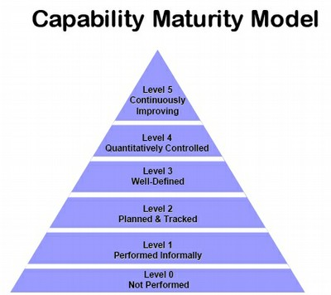

Slide 84
Choosing Between ISO 9001 and CMMi
ISO 9001 is extensively documented:
Improvement of internal documentation
A better quality product
Competitive advantage
Fewer customer audits
Level 3 of the CMM is reachable for an organization that already has ISO 9001 certification.

Slide 85
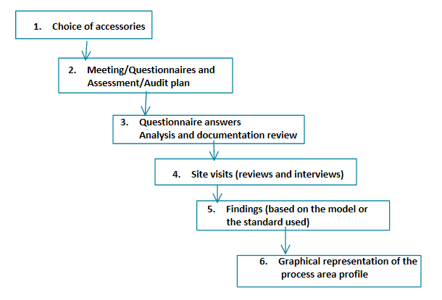

Slide 86
Evaluation Methods (ISO9001/CMMi)
1. Selection of individual for evaluation
2. Validate scope/process with the organization and create an - agreement
3. Analysis of documentation reviews
4. On-site visit conduct reviews and interviews (evaluate/audit)
5. Reporting (nonconformities/opportunities for improvement )

Slide 87
Evaluation Types
Audit: The goal is to investigate a supplier’s or service subcontractor’s development process in on order to make business decision
External Audit: Internal evaluation performed with the help of external auditors (ISO 9001 Certification or Re-Certification)

Slide 88
Evaluation Types
Joint Audit: The goal of which is to evaluate the development process with a team of people from both organization (interfaces with subcontractors)
Self-Audit (Internal): The goal of which is for an organizations to evaluate its own development processes. (Continuous improvement process)

Slide 89
Maturity Model
Maturity model is designed through:
A consensus of experts
Studying the architecture of current models
Multiple mappings of standards and other approved source documents
The addition of specialized practices peculiar to a specific domain

Slide 90
Maturity Model
A rationale for the classification of each practice into a specific maturity level
Experimentation for model adjustment and improvement

Slide 91
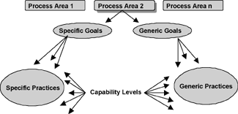
CMMi Architecture (SEI 2002)

Slide 92
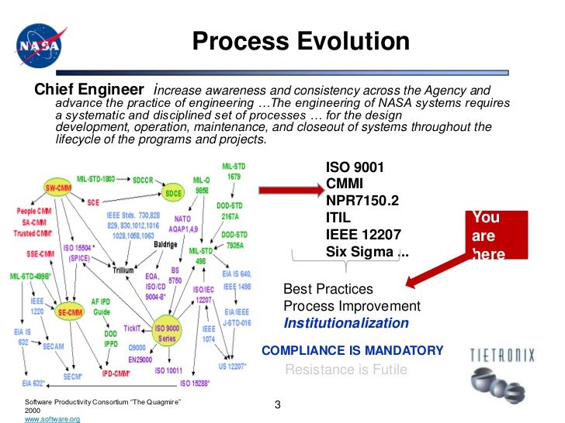

Slide 93
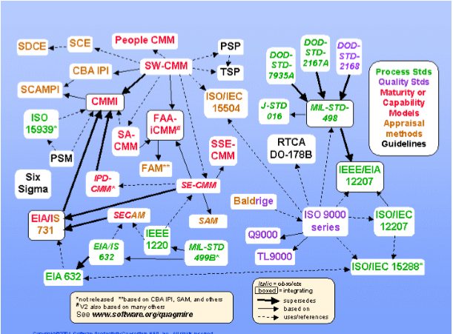
The Software Quagmire

Slide 94
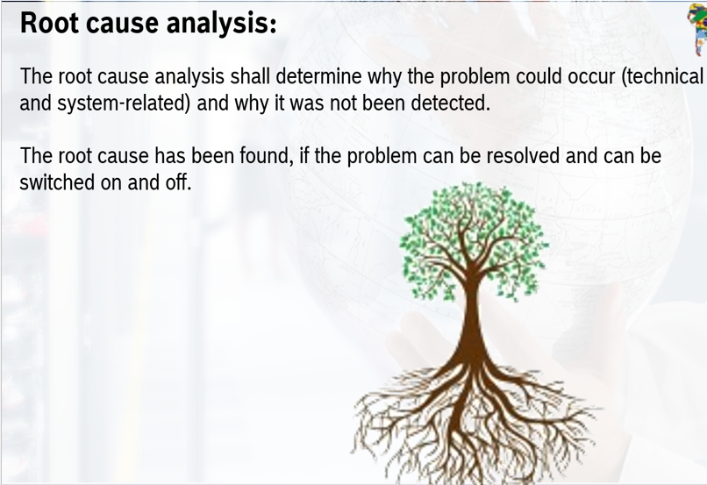
Root Cause Analysis – 3 x 5 Why

Slide 95
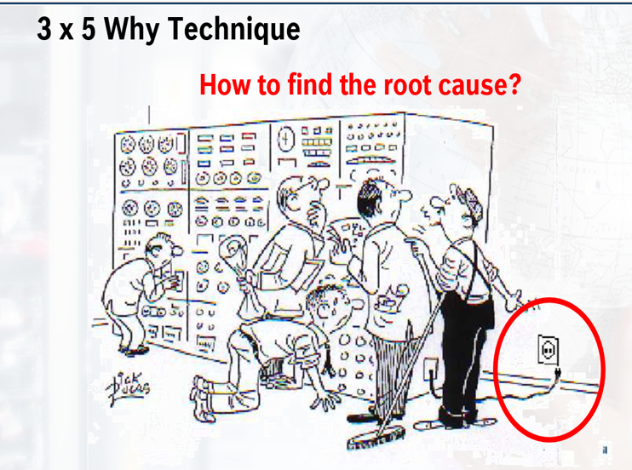

Slide 96
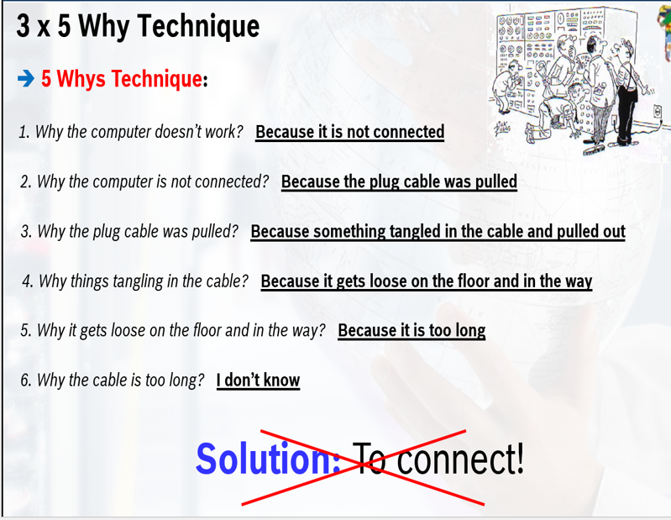

Slide 97
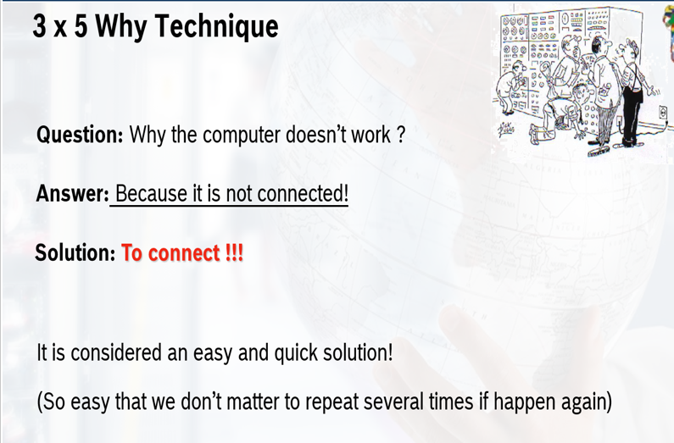

Slide 98
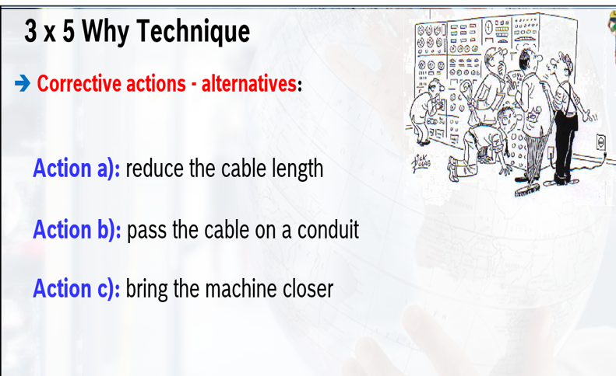

Slide 99
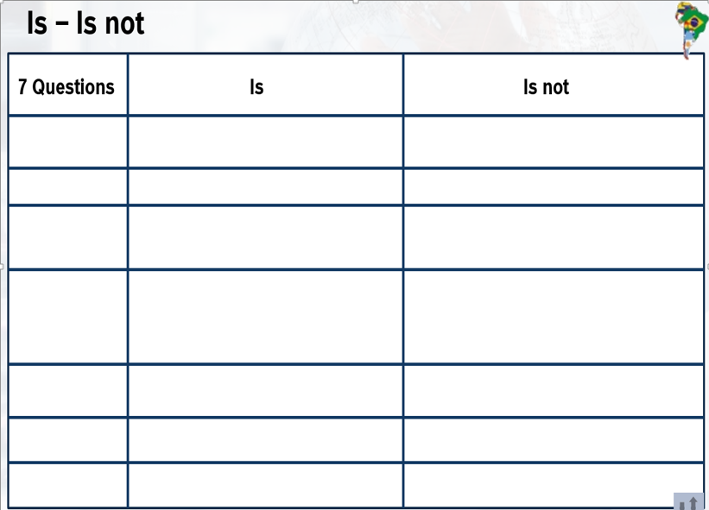

Slide 100
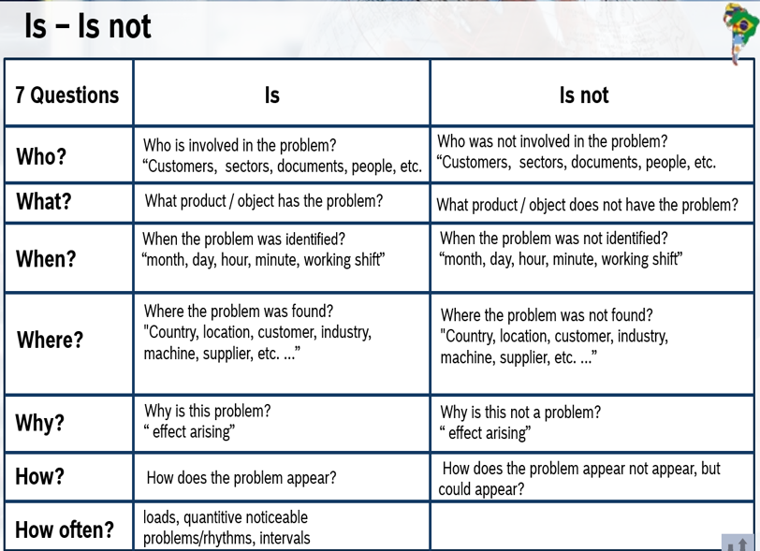

Slide 101
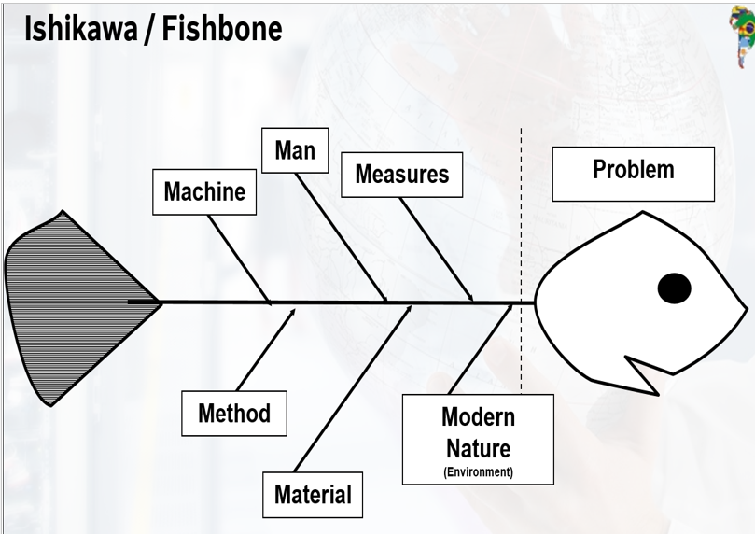

Slide 102
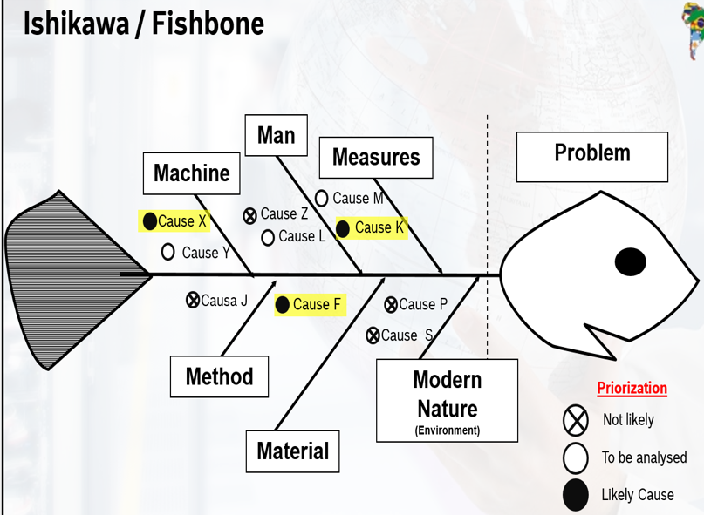

Slide 103
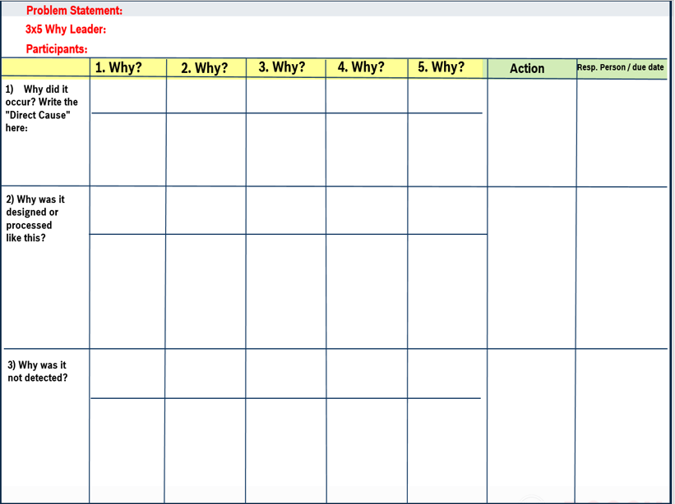

Slide 104
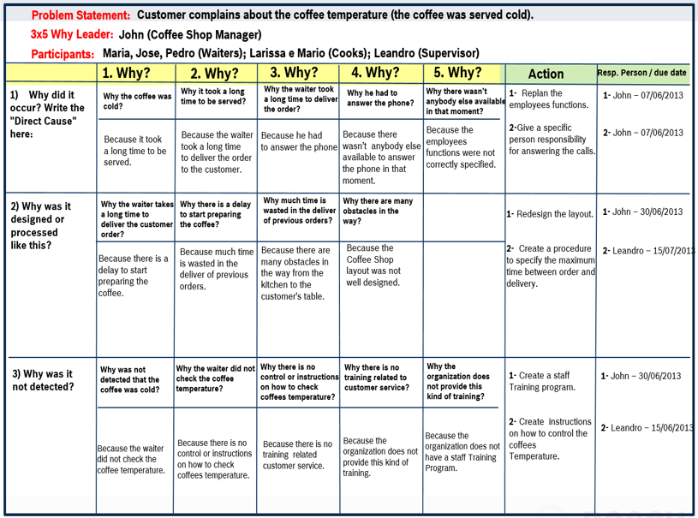

Slide 105
